Slide 1

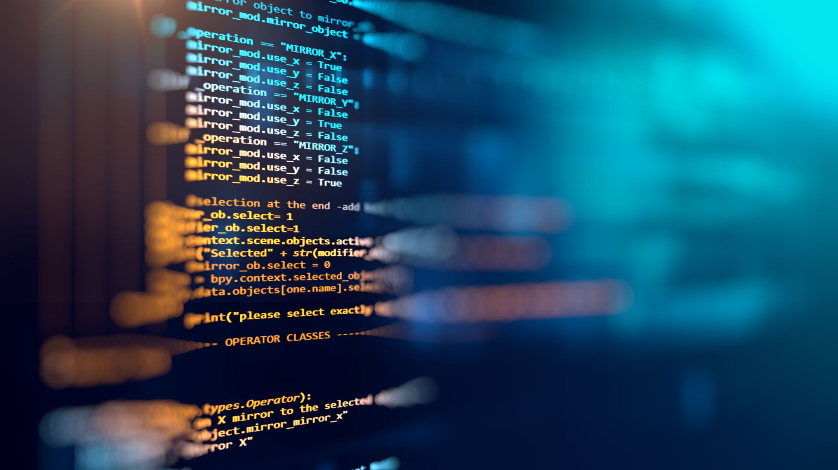
Interlinear Text in Web Pages
Deepankur John Njondimackal

Slide 2
Background
Browse Corpus
Adaptability
Alignment

Slide 3
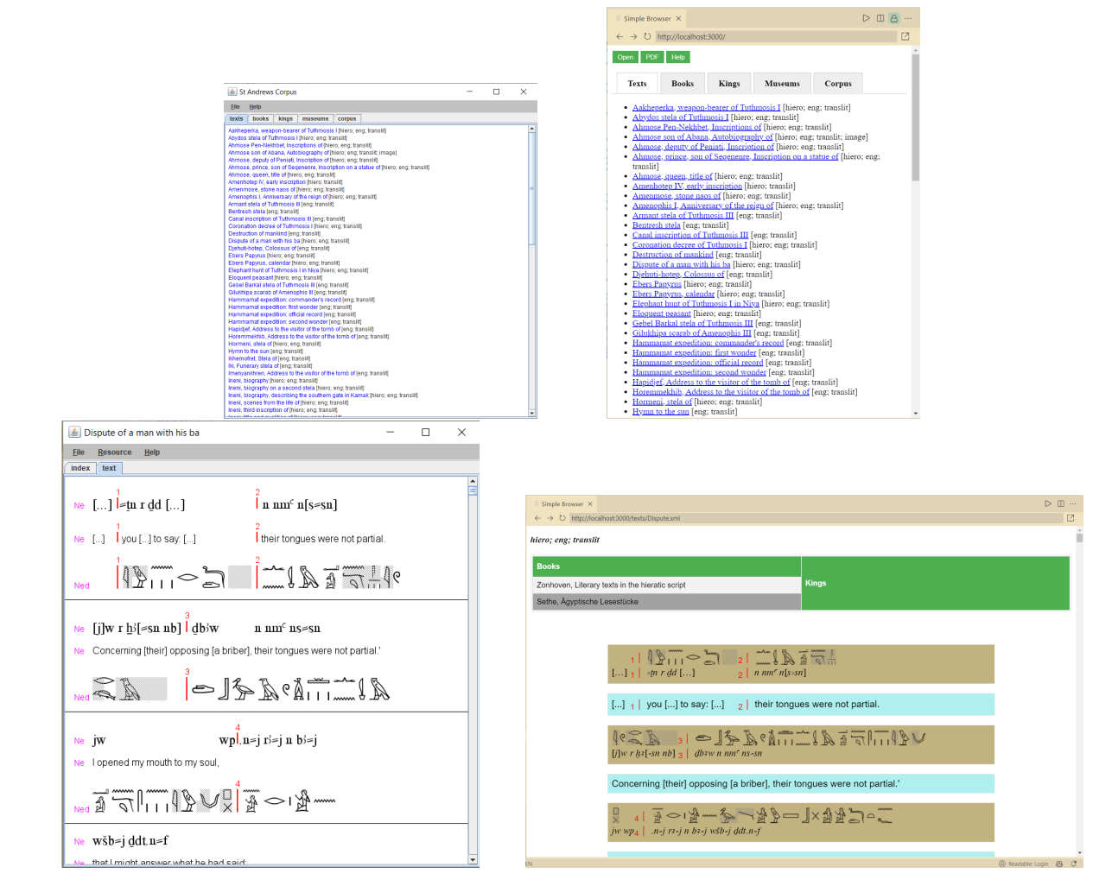

Adapt from Java Program to WebApp

Slide 4
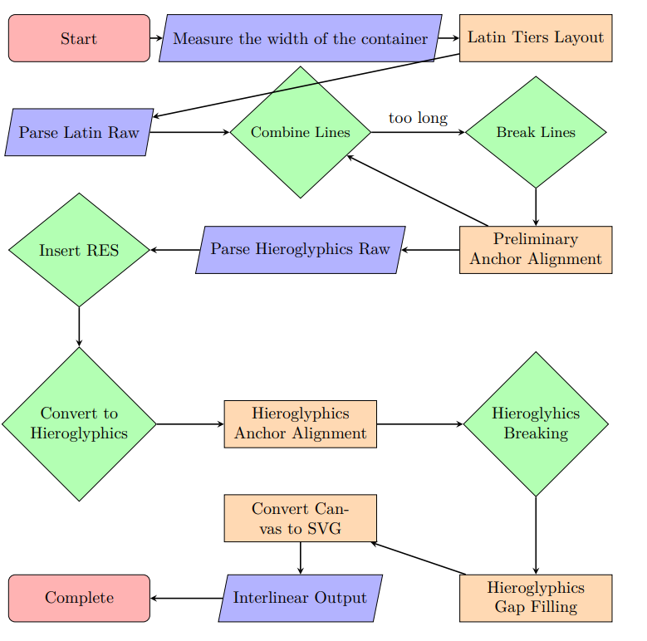
Process Workflow

Slide 5
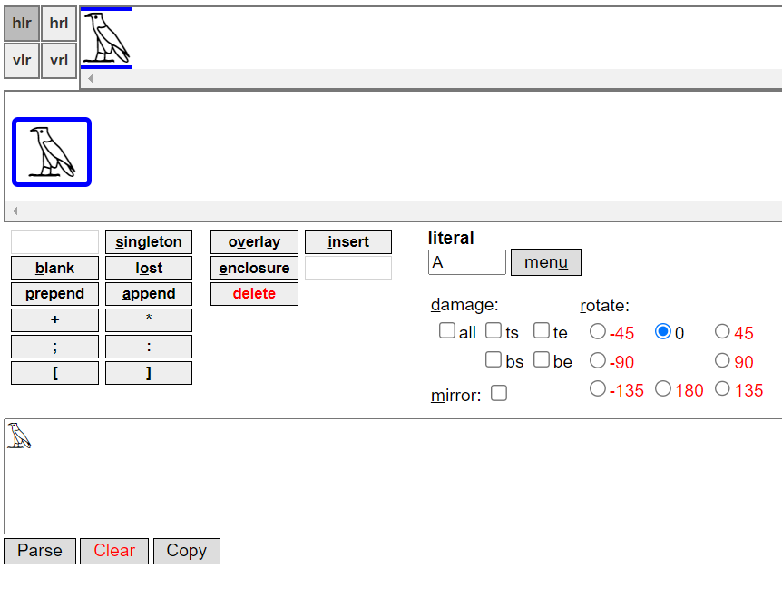
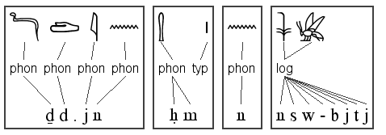
Future Work
Editing
Orthographic Tiers
Include extra info
Precedence alignment
Image Inserts

